Slide 1
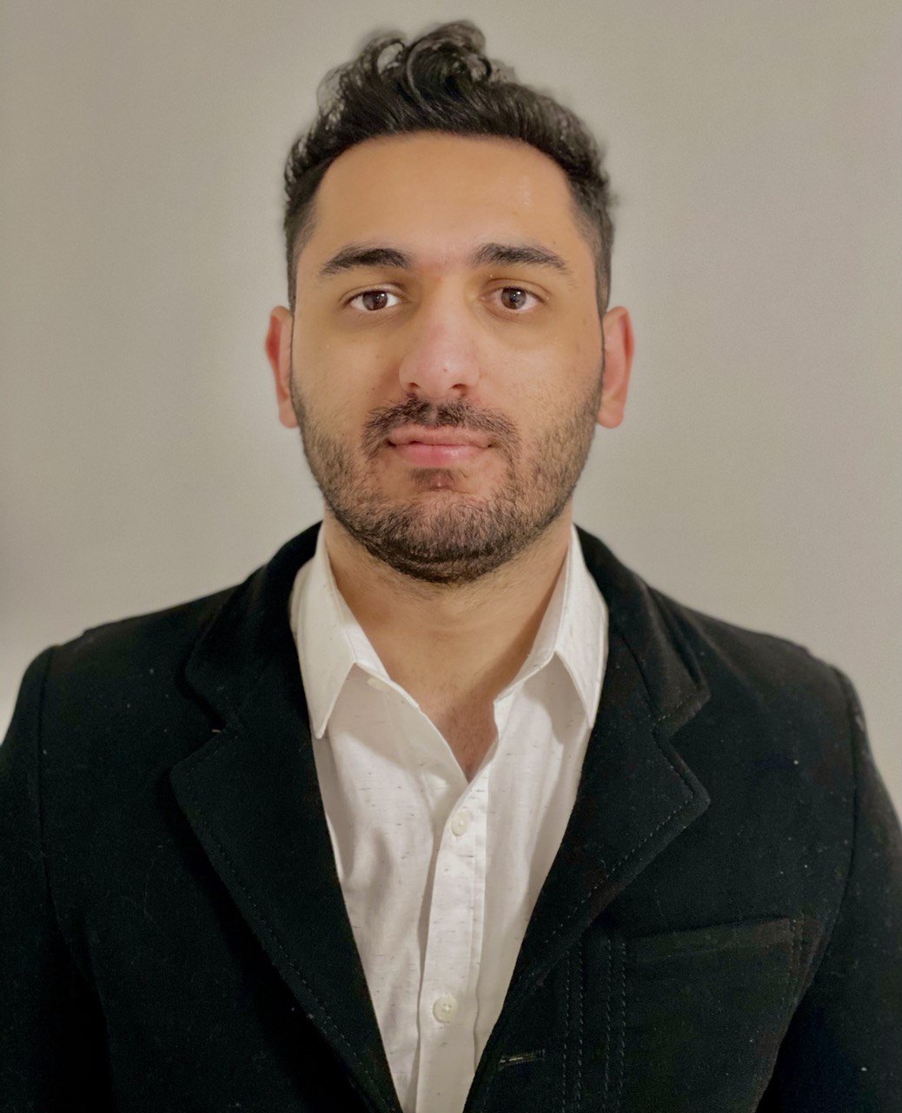

Sepehr Aflatounian
Key Selected Experience
iOS Developer (Automotive @ Ford) 7 month
Fixed iOS defects using an agile methodology and further enhanced the app both on the EV team and remote control team using Swift
Implemented Intelligent charging designs using UIKit and MVVM architecture to enhance charging experience
Developed the comprehensive status page using SwiftUI and Composable Architecture
Machine Learning Engineer (Cyber Security @ EzSec)
Reduced the simulation run time by factor of 10 by asynchronously running parallel attack simulations, and collected network logs using Splunk
Created high performance server to broadcast network data using Python and Cylon to increase data transfer rate by 200% to up to 400Mb/s in Google Cloud Platform
Researched unsupervised clustering algorithms using hyper‑parameter search to identify different phases of cyber attacks with 92% accuracy
Full Stack Developer for Mobile (Automotive / Fleet Management) 8 month
Designed an architecture migration to MVVM for iOS, featuring a new type‑safe API and accessible testing which improved end to end testability
Built Android UI scaffolding, enabling flexible dynamic experiences on the new Android rewrite used by 10K+ users
Reduced lines written for core application flows by 95% through the creation of generic components to encourage code reuse\
Machine Learning Engineer and Full Stack Developer (Real Estate) 8 month
Designed multi‑tag image classifier using transfer learning on ResNet and enhanced accuracy to 96% with augmentation techniques
Developed real estate appraisal using XGBoost based on 12 different parameters and fine‑tuned hyper-parameters to get the accuracy of 94%
Implemented web application using Postgres SQL, React, Express, Node, Django featuring <50ms latency WebRTC live open house feature
Analyst, Full Stack Developer
Software Engineering TC
Toronto
Avanade, Inc.
sepehr.aflatounian@avanade.com
6479852468
Areas of Expertise
Technical
Azure Developer Cloud
iOS Swift
PyTorch Python
React Frontend
C# and Python Backend
Industry
Automotive
Gaming
SAAS Software CRM
Real Estate
Cyber Security
Professional Background
I worked on the FordPass iOS app for the last 7 month and also I have graduated from University of Waterloo and I have completed 6 co-op terms. I have worked in automotive, gaming, fleet management and Real Estate industries developing web and mobile based solution and also developing intelligent (Machine Learning Solutions) for them

